Slide 1
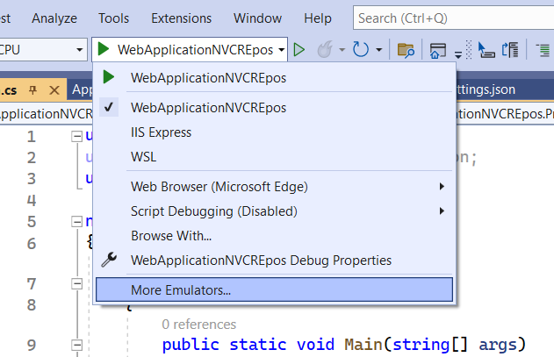
using Microsoft.EntityFrameworkCore;
using Microsoft.Extensions.Configuration;
using WebApplicationNVCREpos.Models;
namespace WebApplicationNVCREpos
{
public class Program
{
public static void Main(string[] args)
{
var builder = WebApplication.CreateBuilder(args);
// Add services to the container.
builder.Services.AddControllersWithViews();
builder.Services.AddDbContextPool<Appdbcontexts>(
options => options.UseSqlServer(builder.Configuration.GetConnectionString("EmployeeDBConnection")));
var app = builder.Build();
// Configure the HTTP request pipeline.
if (!app.Environment.IsDevelopment())
{
app.UseExceptionHandler("/Home/Error");
// The default HSTS value is 30 days. You may want to change this for production scenarios, see https://aka.ms/aspnetcore-hsts.
app.UseHsts();
}
app.UseHttpsRedirection();
app.UseStaticFiles();
app.UseRouting();
app.UseAuthorization();
app.MapControllerRoute(
name: "default",
pattern: "{controller=Home}/{action=Index}/{id?}");
app.Run();
}
}
}
The web application used to configure the HTTP pipeline, and routes.
Adds services for controllers to the specified Microsoft.Extensions.DependencyInjection.IServiceCollection.
// This method will not register services used for pages.
A collection of services for the application to compose. This is useful for adding
// user provided or framework provided services.
Configures the context to connect to a Microsoft SQL Server database.
Registers the given Microsoft.EntityFrameworkCore.DbContext as a service in the
// Microsoft.Extensions.DependencyInjection.IServiceCollection, and enables DbContext
// pooling for this registration.
// DbContext pooling can increase performance in high-throughput scenarios by re-using
// context instances. However, for most application this performance gain is very
// small.

Slide 2
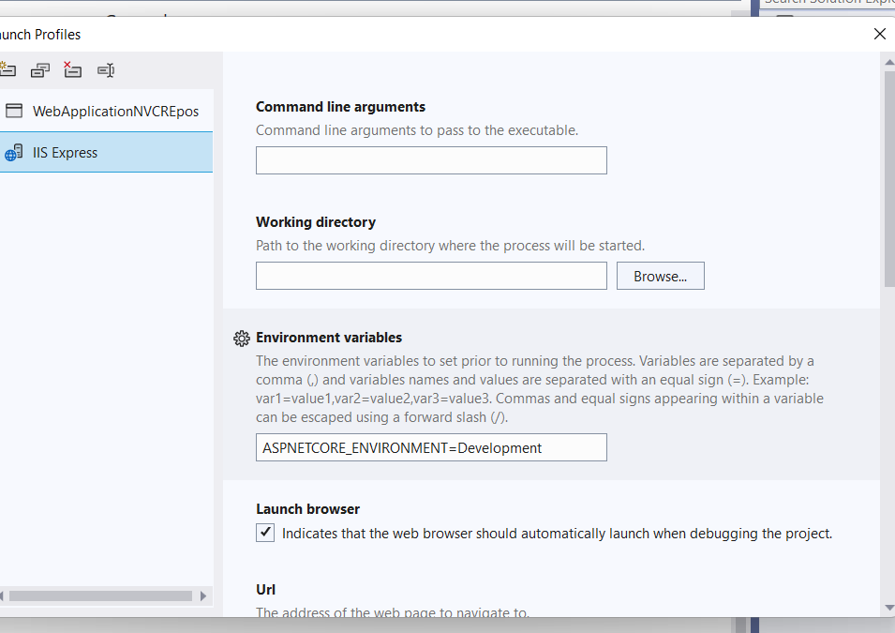
using Microsoft.EntityFrameworkCore;
using Microsoft.Extensions.Configuration;
using WebApplicationNVCREpos.Models;
namespace WebApplicationNVCREpos
{
public class Program
{
public static void Main(string[] args)
{
var builder = WebApplication.CreateBuilder(args);
// Add services to the container.
builder.Services.AddControllersWithViews();
builder.Services.AddDbContextPool<Appdbcontexts>(
options => options.UseSqlServer(builder.Configuration.GetConnectionString("EmployeeDBConnection")));
var app = builder.Build();
// Configure the HTTP request pipeline.
if (!app.Environment.IsDevelopment())
{
app.UseExceptionHandler("/Home/Error");
// The default HSTS value is 30 days. You may want to change this for production scenarios, see https://aka.ms/aspnetcore-hsts.
app.UseHsts();
}
app.UseHttpsRedirection();
app.UseStaticFiles();
app.UseRouting();
app.UseAuthorization();
app.MapControllerRoute(
name: "default",
pattern: "{controller=Home}/{action=Index}/{id?}");
app.Run();
}
}
}
Checks if the current host environment name is Microsoft.Extensions.Hosting.EnvironmentName.Development.

Slide 3
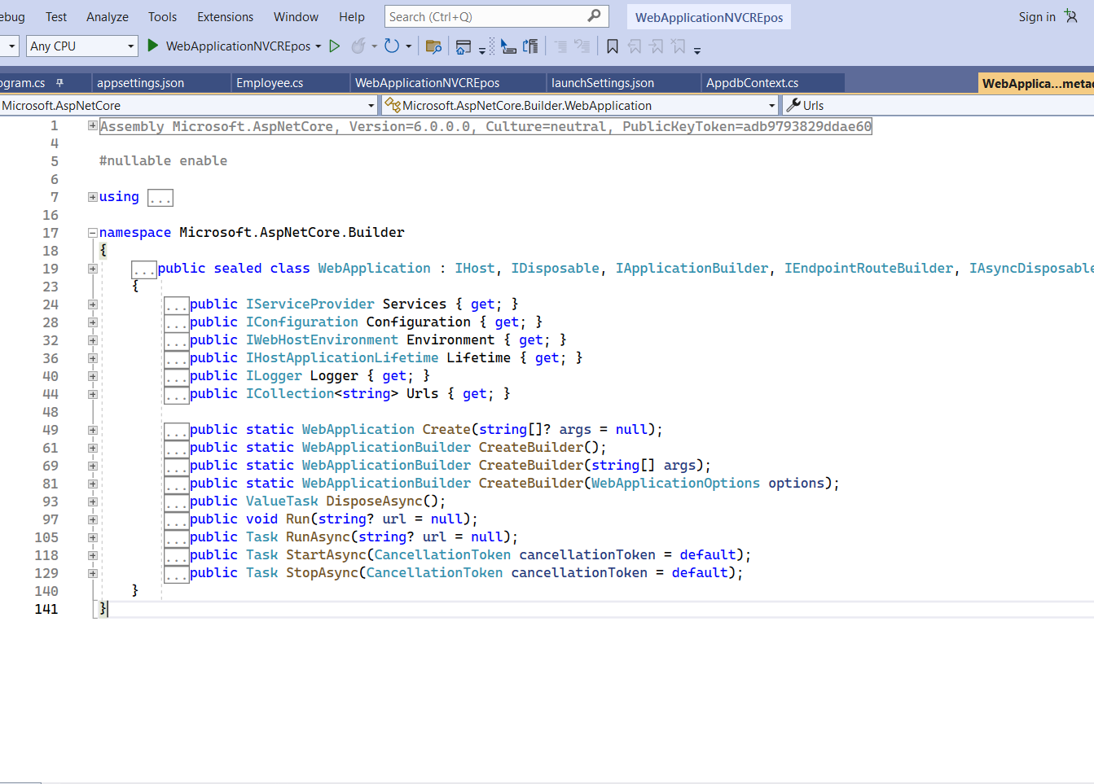
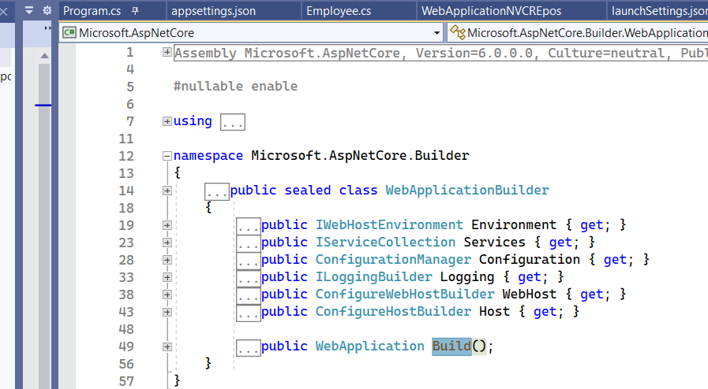
// Summary:
// Builds the Microsoft.AspNetCore.Builder.WebApplication.
//
// Returns:
// A configured Microsoft.AspNetCore.Builder.WebApplication.

Slide 4
Q1. WebApplication.CreateBuilder(args);
In above code CreatrBuilder method will return reference of ___________ class
Q2. What is the return type of Build method
Q3. ___________ class is used to configure HTTP pipe line
Q4. what is the return type of Services getter method.
Q5. Run method is available in which class?

Slide 5
1.program.cs➔[decide server(kesteral/IIS/IISExpress),
register services(
Controllerviews, sqlServer,Session,userdefine class),
middleware configuration(useSession,useStaticFiles,UseCors)]
2.HomeController/Index(method)
➔Calling Views
3._ViewStart.cshtml
4. _Layout
5.indexViews(Views/Home/Index)
@RendeBody();

Slide 6
What is CreateBuilder in ASP.NET Core?
CreateBuilder() Initializes a new instance of the WebApplicationBuilder class with preconfigured defaults.
Use of WebApplication class
The web application used to configure the HTTP pipeline, and routes.
WebApplicationBuilder class
A builder for web applications and services
What is WebApplicationBuilder?
A collection of configuration providers for the application to compose.
This is useful for adding new configuration sources and providers.
Environment.
Provides information about the web hosting environment an application is running.
.
Services
What are the services in ASP.NET Core?
There are basically two types of services in ASP.NET Core:
Framework Services: Services which are a part of ASP.NET Core framework such as IApplicationBuilder,
IHostingEnvironment, ILoggerFactory etc.
Application Services: The services (custom types or classes) which you as a programmer create for your application.

